Slide 1
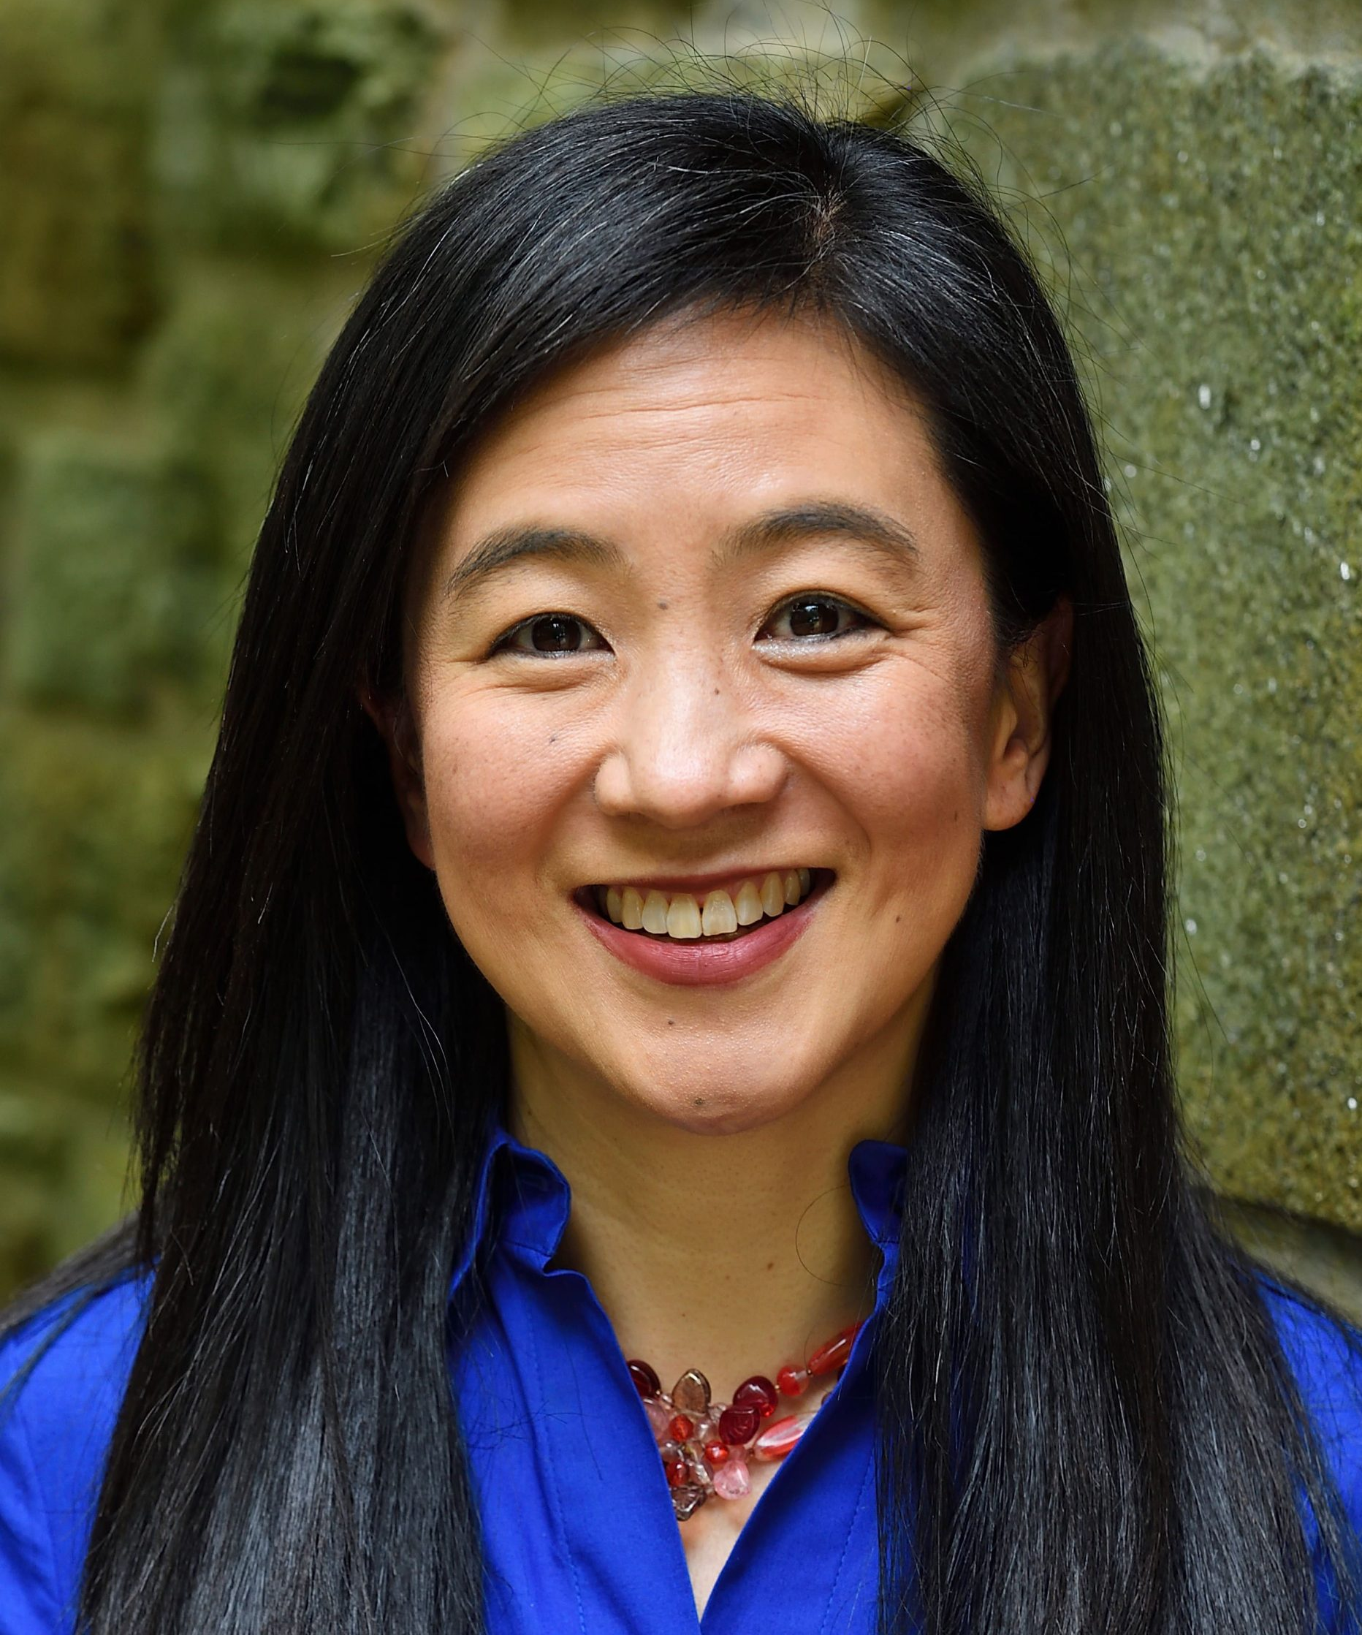
Vivek H. Murthy Distinguished Lecture Series
for Public Health Leadership
A Virtual Conversation with
U.S. Surgeon General Dr. Vivek H. Murthy and Dr. Hahrie Han
Fostering Social Connection to Enhance Health and Wellbeing
Co-sponsors:
HHS Office of Equal Employment Opportunity, Diversity & Inclusion
HHS Health Resources and Services Administration (HRSA) AAPI ERG
NIH Office of Equity, Diversity, and Inclusion (EDI)
US Public Health Service Asian Pacific American Officers Committee (USPHS APAOC)
The Association of Asian/Pacific Islander Employees of CDC/ATSDR (AAPIECA)
Substance Abuse and Mental Health Services Administration (SAMHSA) OBHE​
Thursday, May 23, 2024, 2 to 3 pm EDT
https://videocast.nih.gov/watch=54661
In celebration of Asian American, Native Hawaiian & Pacific Islander Heritage Month

